Slide 1
Welcome to CS4141 PSLG!
With Robert and Jakub

Slide 2

Java while loop
The while loop loops through a block of code as long as a specified condition is true:
Syntax:
while (condition) {
// code block to be executed
}
Example:
int i = 0;
while (i < 5) {
System.out.println(i);
i++;
}

Slide 3
Java do/while loop
The do/while loop is a variant of the while loop. This loop will execute the code block once, before checking if the condition is true, then it will repeat the loop as long as the condition is true.
Syntax:
do {
// code block to be executed
}
while (condition);
Example:
int i = 0;
do {
System.out.println(i);
i++;
}
while (i < 5);

Slide 4
Problem 1
Write a Java program that:
uses a while loop to print numbers from 1 to 10.

Slide 5
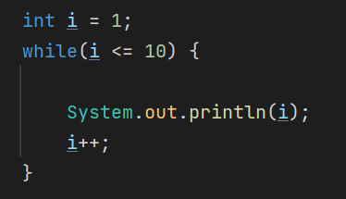
Answer:

Slide 6
Problem 2
Write a Java program to:
to sum the first n even numbers using a while loop.

Slide 7
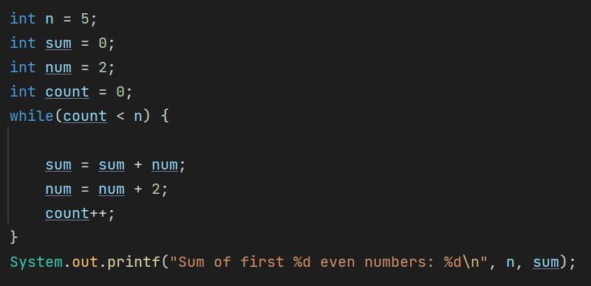
Answer:

Slide 8
Reminder - Java while loop
The while loop loops through a block of code as long as a specified condition is true:
Syntax:
while (condition) {
// code block to be executed
}
Example:
int i = 0;
while (i < 5) {
System.out.println(i);
i++;
}

Slide 9
Problem 3
Write a Java program to:
find the factorial of a given number using a while loop.

Slide 10
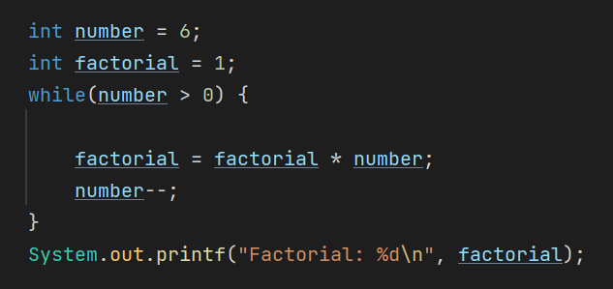
Answer:

Slide 11
Problem 4
Write a Java program to:
Determine and print the number of digits in the number 987654321.

Slide 12
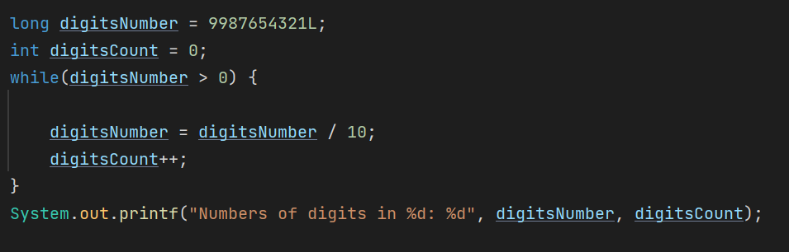
Answer:

Slide 13
Thank you for coming!

